Slide 1


Energy transition - Project
Zazie Heinesch - Guayaquil

Slide 2
Outline
Technologies used
Electrical mix, first idea
Improvement idea
Weather and topography analysis
Mathematical model for a dam
Final electrical mix
Conclusion

Slide 3


Technologies
But also :
Photovoltaic panels
Wind turbine
Battery
Import
Export
Implementing in a model of expansion planning

Slide 4
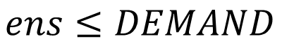
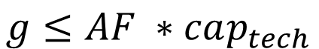
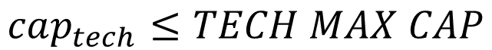
Model formulation
Market clearing:
$$g+ens+\left(sd −sc\right)+import −export=DEMAND$$
Import :
$$import≤IMPORT MAX CAP$$
Export :
$$export≤EXPORT MAX CAP$$
Technologies :
$$cap_{tech}≤TECH MAX CAP$$
Power :
$$g≤AF ∗cap_{tech}$$
Energy not served :
$$ens≤DEMAND$$
Fuel cost :
$$fcd≤g ∗MARGINAL FUEL COST$$

Slide 5
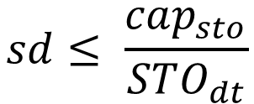
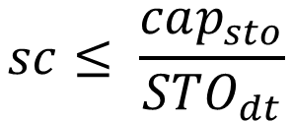
Storage equation :
$$cap_{sto}≤STO MAX CAP$$
$$e_{t+1} −e_{t}=τ η^{c}{sc}_{t}−τ\frac{sd_{t}}{η^{d}}$$
$$e_{t=0} −e_{t=T}=−τ sd_{T} −τsc_{T}$$
$$sc≤ \frac{cap_{sto}}{STO_{dt}}$$
$$sd≤ \frac{cap_{sto}}{STO_{dt}}$$
$$SOC MIN ∗cap_{sto}≤ se≤SOC MAX ∗cap_{sto}$$

Slide 6
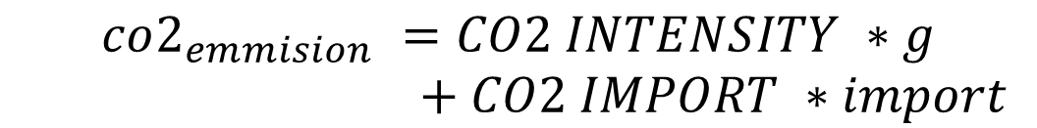
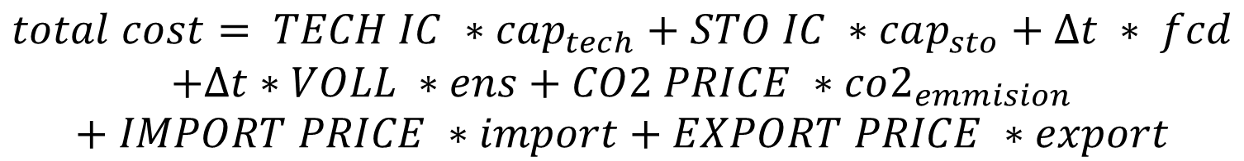
CO2 emissions :
$$co2_{emmision} =CO2 INTENSITY ∗g$$
$+ CO2 IMPORT ∗import$
CO2 maximum:
$$co2_{emmision}=CO2 BOUND$$
Curtailment:
$$curt =\left(AF ∗cap_{tech}−g\right)∗RE MASK$$
Total cost (objective function):
$$total cost= TECH IC ∗cap_{tech}+STO IC ∗cap_{sto}+Δt ∗ fcd$$
$$+Δt∗VOLL ∗ens+CO2 PRICE ∗co2_{emmision}$$
$$+ IMPORT PRICE ∗import+EXPORT PRICE ∗export$$

Slide 7
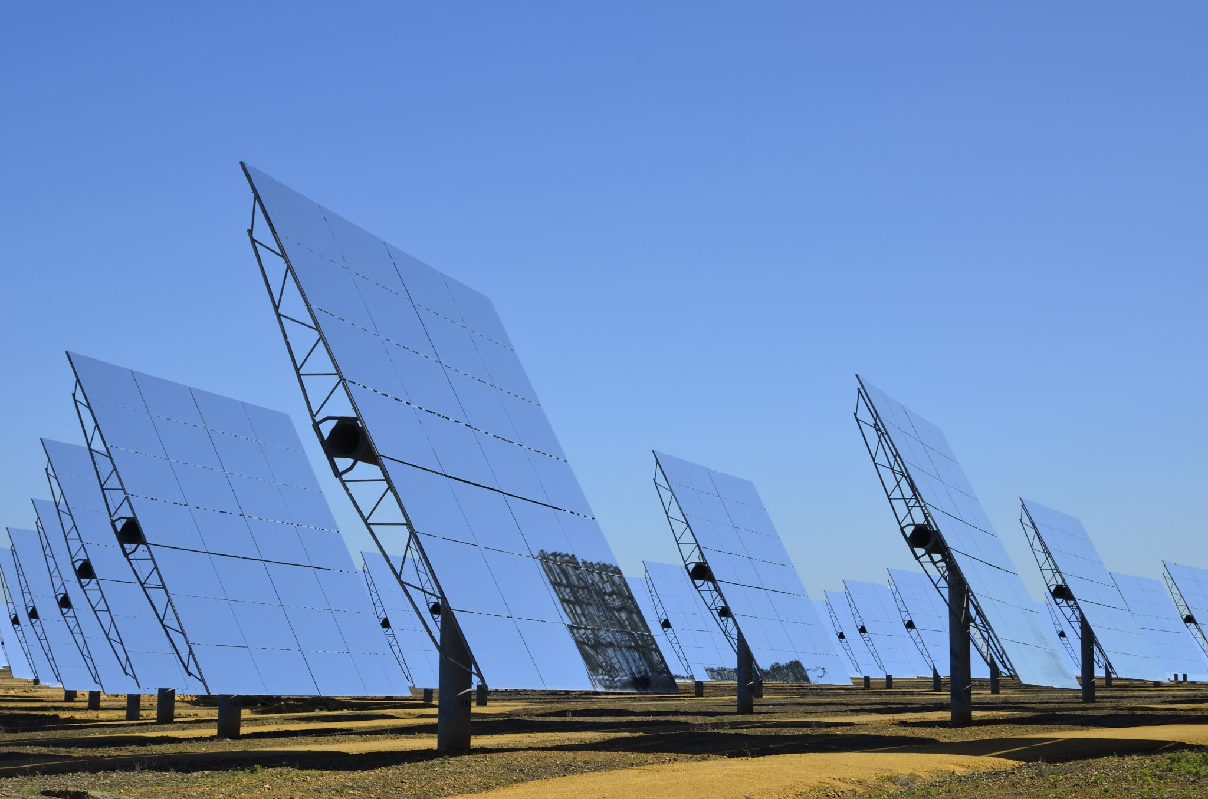

PV panels
→unlimited capacity
Efficiency of 20.5%
Lifetime of 35 years
Investment cost = 870 k€/MW
O&M fixed = 10.6 k€/MW/y
O&M variable = 10 €/MWh/y
Source: Danish Energy Agency (Technology Data for Generation of Electricity and District Heating)

Slide 8

Wind turbine
→ unlimited capacity
Efficiency of 47%
Lifetime of 27 years
Investment cost = 1.11 M€/MW
O&M fixed = 16.4 k€/MW/y
O&M variable = 2 €/MWh/y
Source: Danish Energy Agency (Technology Data for Generation of Electricity and District Heating)

Slide 9
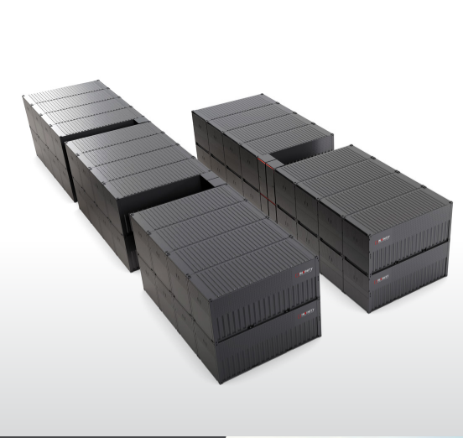
Battery
Battery of 3 MW
→ Maximal capacity of 12 MWh
Efficiency of 85 %
State of charge $∈[0.2;0.8]$
State of charge ∈[0.2;0.8]
Investment cost = 500 k€/MWh
During 4h
Lifetime = 25 years
Source : Invinity data sheet (https://invinity.com/wp-content/uploads/2024/12/Invinity-ENDURIUM-Data-Sheet-MAR000020-2024-12.pdf?_gl=1*lzgj6v*_up*MQ..*_gs*MQ..&gclid=CjwKCAiA65m7BhAwEiwAAgu4JFqYz_U4PtidA2i2jJlRaFiS13FNLzbv9fz0VtaHFF2xsj7x1VRSZBoCTVQQAvD_BwE)

Slide 10
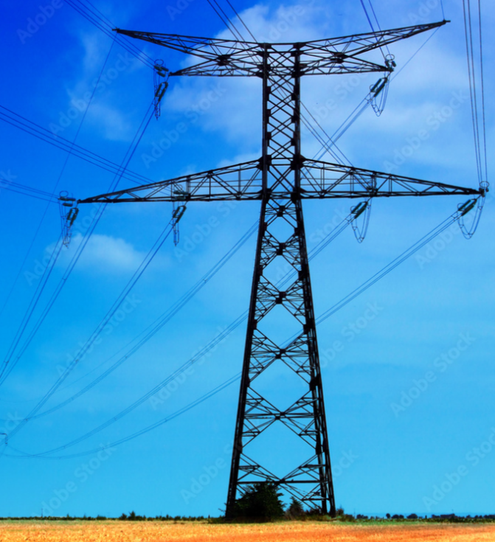
National grid
Import and Export
Export price of 20 €/MWh
Composed of 80 % of hydropower
→ import not expensive
→ Unlimited capacity
Import price of 74 €/MWh
Source: data find with optimisation during previous quadrimester

Slide 11
Demand
Electrical consumption of 31.6 GWh
Colling produce with absorption chiller → solar pannel and biomass, so no electrical consumption.
→ total demand of 31.6 GWh

Slide 12
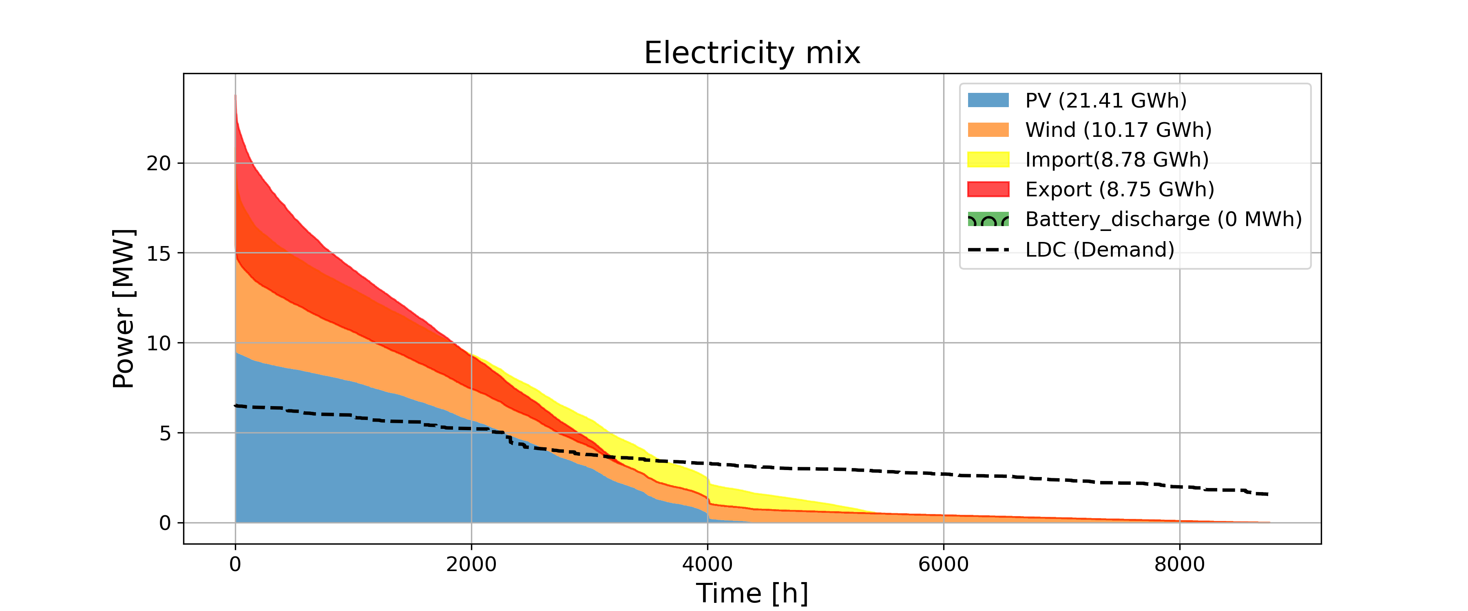
Electrical mix – First version
7.1 MW of wind turbine
1.562 M€
12.9 MW of PV
LCOE = 49.40 €/MWh

Slide 13
Comparaison with results of last semester
P
Last semester
LCOE = 60 €/MWh
Wind turbine = 4.9 MW
PV = 4.4 MW
Energy stored = 3.5 GWh
This semester
LCOE = 49 €/MWh
Wind turbine = 7.1 MW
PV = 12.9 MW
Energy stored = 0 GWh
Same import and export price, but enhance of renewable energy and battery prices which were not accurate (particullary information about PV).

Slide 14

A step further
The national energy mix contains 80% hydropower. However, hydropower prices vary significantly depending on rainfall.
➔ Design and implementation of a dam on campus, along with analysis over several weather years using uncertainty model.

Slide 15
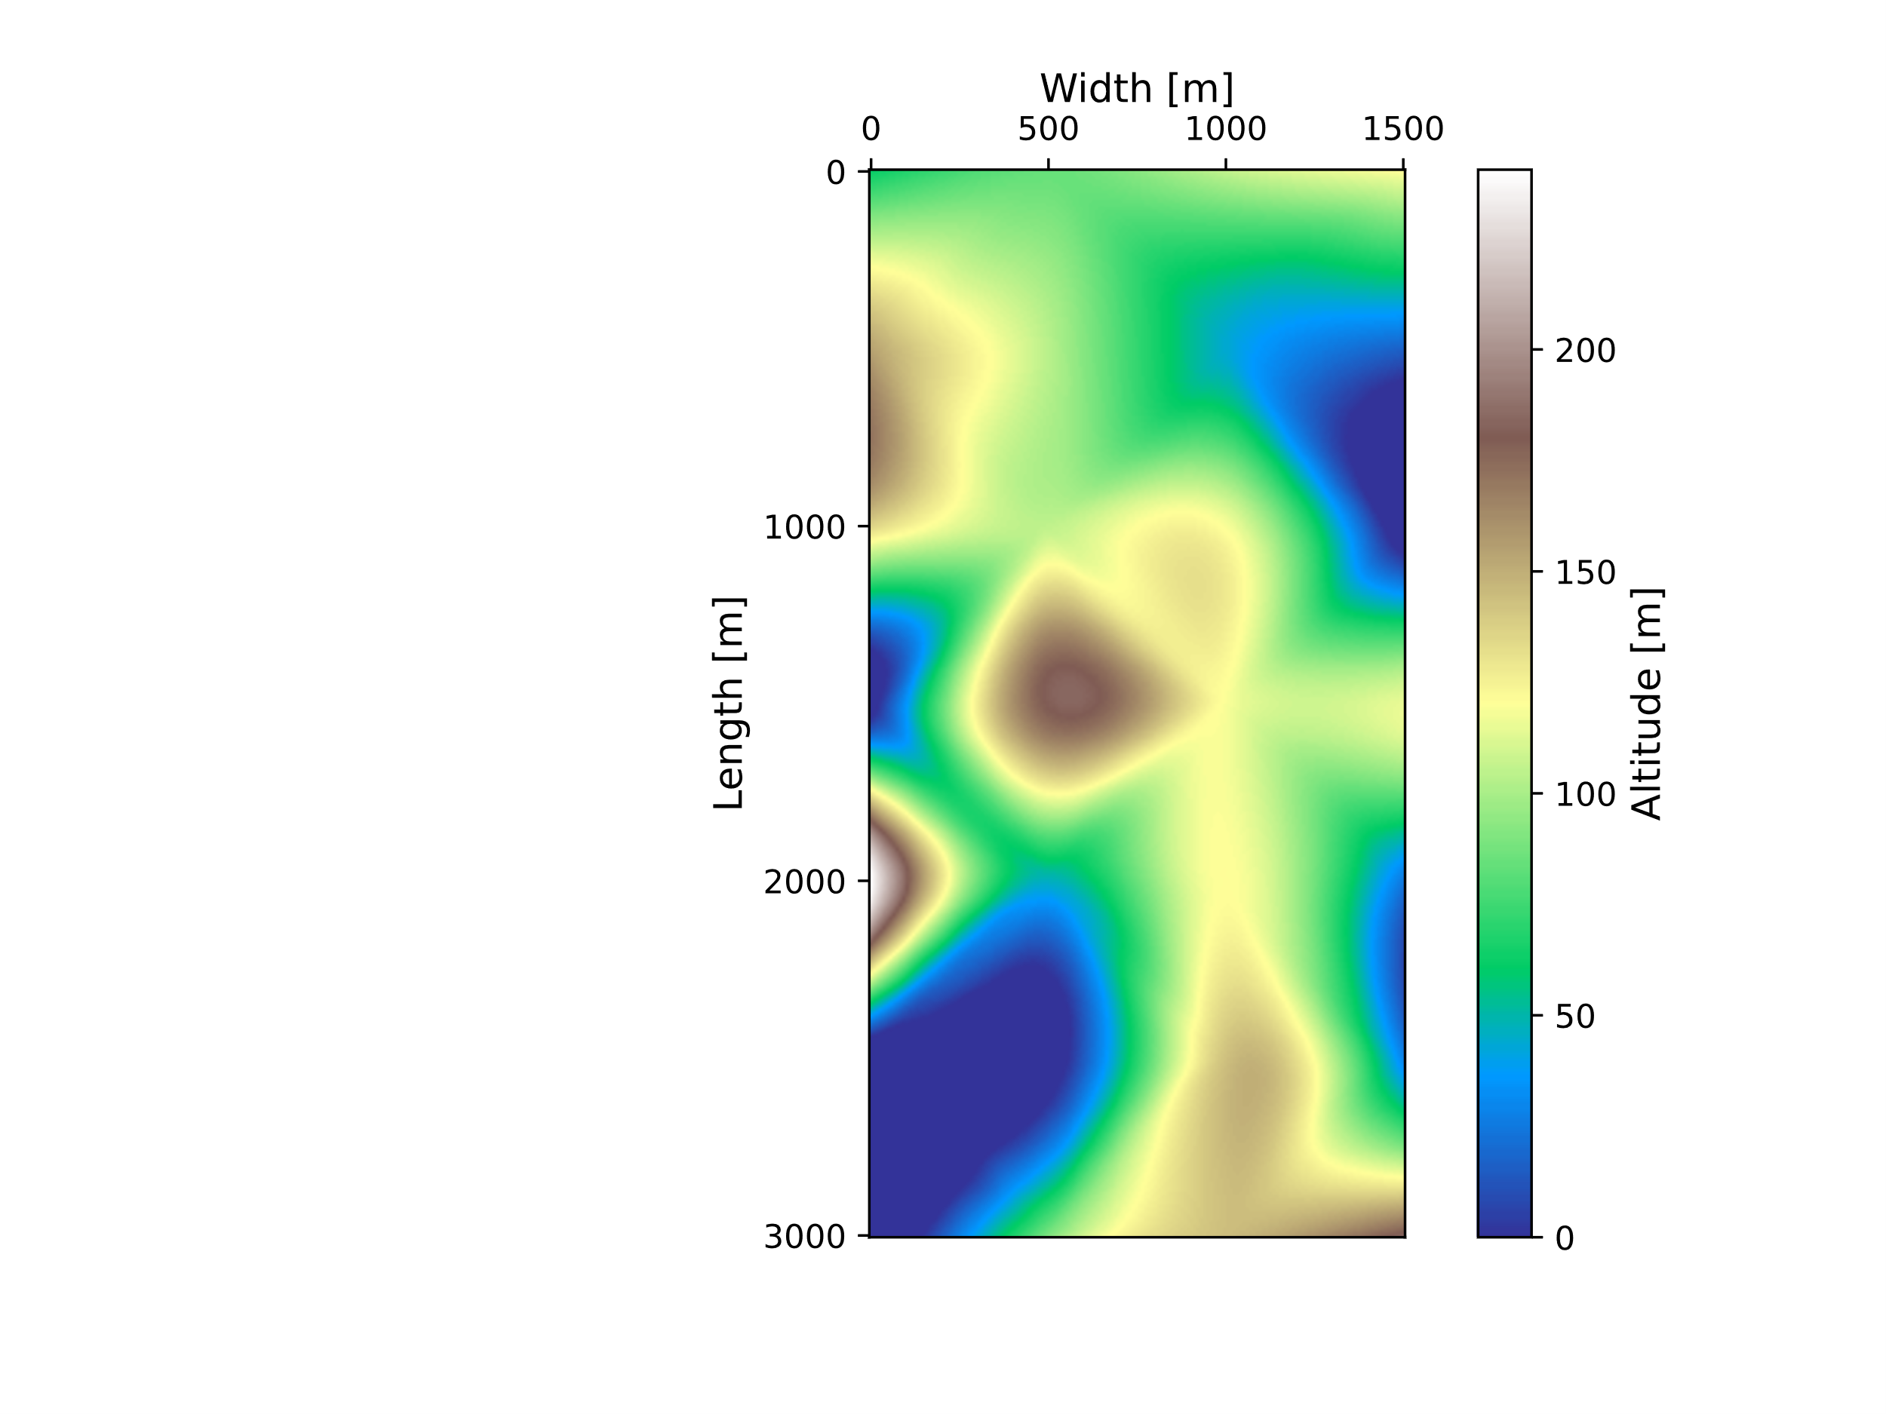
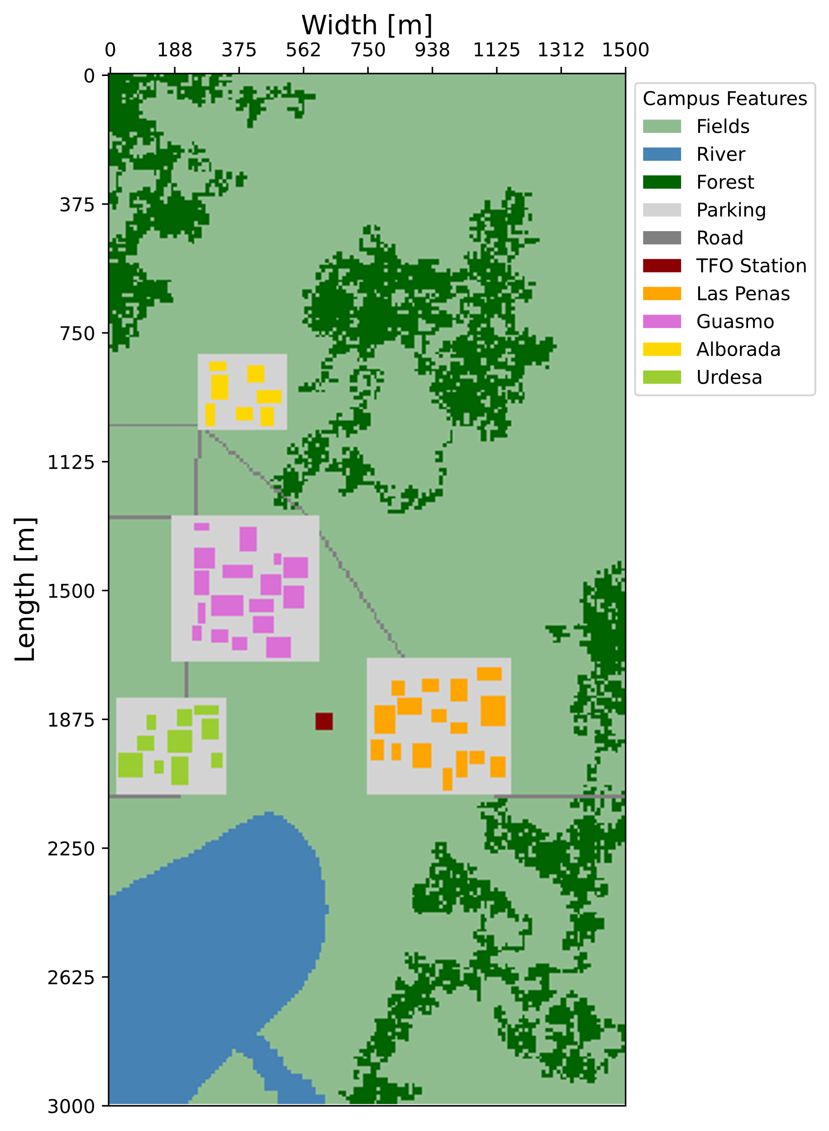
Topography analysis
River available on the campus
Head of 150m
Installation of the dam there

Slide 16
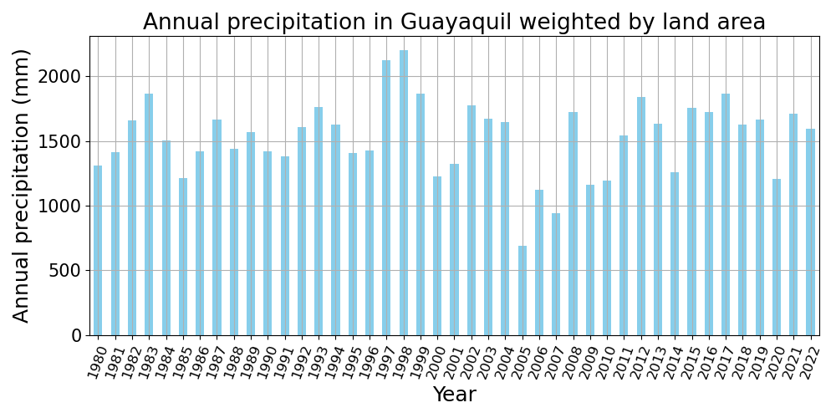
Weather analysis
Average year
Source: Renewable ninja (https://www.renewables.ninja)
Dry year
Humid year

Slide 17
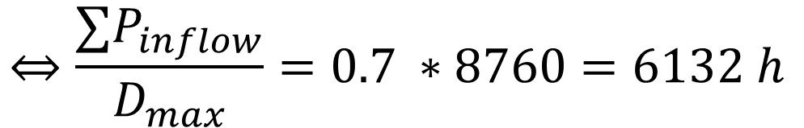
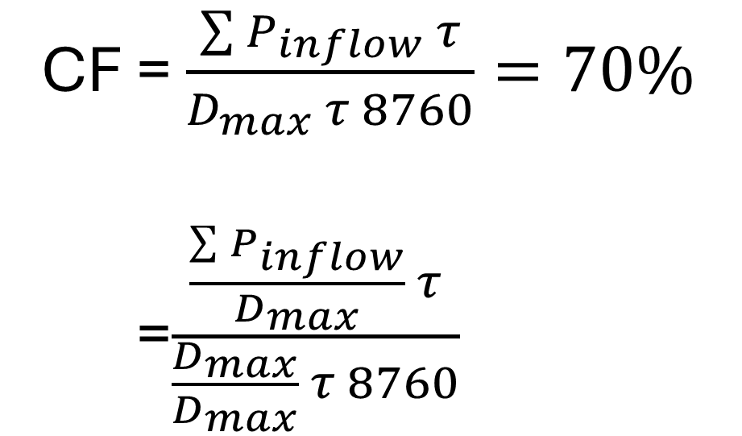
Precipitation translation
[MWh]
Dimensionalised using an average year (2022) as reference.
CF = $\frac{\sum{P_{inflow}} τ}{D_{max}{τ 8760}}=70\%$
=$\frac{\frac{\sum{P_{inflow}}}{D_{max}} τ}{\frac{D_{max}}{D_{max}}{τ 8760}}$
$$⇔\frac{∑P_{inflow}}{D_{max}}=0.7 ∗8760=6132 h$$

Slide 18
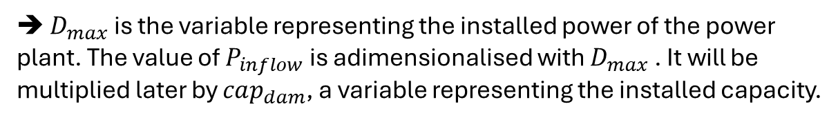
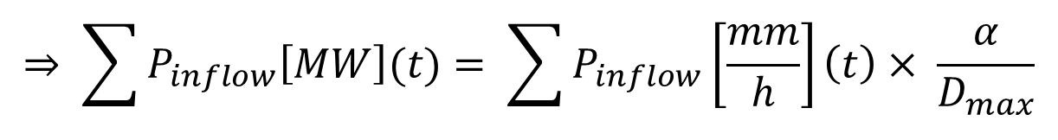
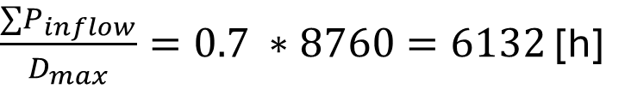
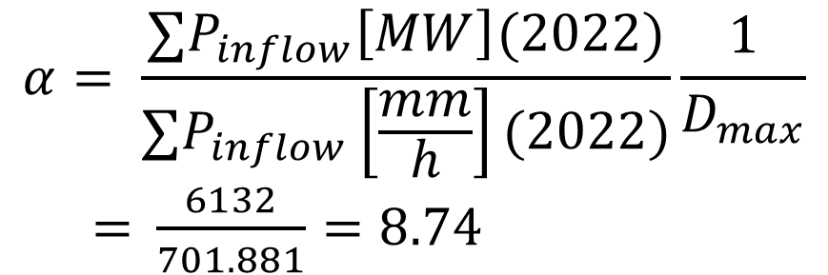
Precipitation translation
$\frac{∑P_{inflow}}{D_{max}}=0.7 ∗8760=6132$ [h]
$$α= \frac{{∑P}_{inflow}\left[MW\right](2022)}{{∑P}_{inflow}\left[\frac{mm}{h}\right](2022)}\frac{1}{D_{max}}$$
$=$ $\frac{6132}{701.881}=8.74$
Constant converting all the precipitation in power
$$⇒ \sum{P_{inflow}\left[MW\right](t)= \sum{P_{inflow}\left[\frac{mm}{h}\right]\left(t\right)× \frac{α}{D_{max}}}}$$
➔ $D_{max}$ is the variable representing the installed power of the power plant. The value of $P_{inflow}$is adimensionalised with $D_{max}$ . It will be multiplied later by $cap_{dam}$, a variable representing the installed capacity.

Slide 19
Assumptions
Uncertainty is applied on the model
Propability of 60% of an average year, based on precipitation.
Probablility of 20% for a dry year
Probability of 20% for a humid year.

Slide 20

Dam
Capacity stored : 100 MWh
Empty in 20h
Assume already constructed
→ Investment price of 0 €/MWh
Efficiency of 75%
Lifetime = 75 years

Slide 21
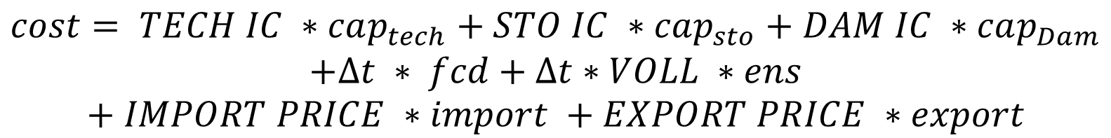
Model formulation: change
Market clearing:
$$g+ens+\left(sd −sc\right)+import −export+sd_{dam}$$
$$=DEMAND$$
Cost scenario :
$$cost= TECH IC ∗cap_{tech}+STO IC ∗cap_{sto}+DAM IC ∗cap_{Dam}$$
$$+Δt ∗ fcd+Δt∗VOLL ∗ens$$
$$+ IMPORT PRICE ∗import +EXPORT PRICE ∗export$$
Total cost (objective function) :
$$total cost= TECH IC ∗cap_{tech}+STO IC ∗cap_{sto}+DAM IC ∗cap_{Dam}$$
$$+ (PI ∗(Δt ∗ fcd+Δt∗VOLL ∗ens +CO2 PRICE ∗co2_{emmision})$$
Where PI is the probability than a scenario happens

Slide 22
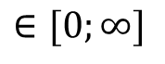
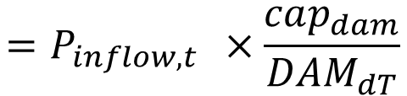


Dam storage equations
No environmental flow is considered
Balance :
$$∈[0;∞]$$
$e_{t+1} −e_{t}=τ η^{c}{sc}_{t}−τ\frac{sd_{t}}{η^{d}}+τ\left(p_{inflow,t}−P_{outflow,t} −P_{spill,t}\right)$
$$=P_{inflow,t } ×\frac{cap_{dam}}{DAM_{dT}}$$
Only power generation, no pumping.
Initial state :
$$e_{t=0} −e_{t=T}=−τ sd_{T} −τP_{spill, T}+τP_{inflow, T}$$
Where T is the last time step

Slide 23
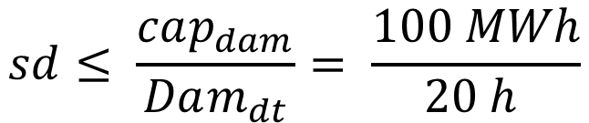
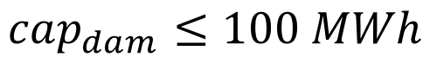
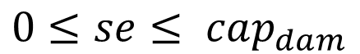
Capacity max :
This maximum capacity corresponds to a reservoir holding 326 200 m³ of water.
$$cap_{dam}≤100 MWh$$
Discharge max :
$$sd≤ \frac{cap_{dam}}{Dam_{dt}}= \frac{100 MWh}{20 h }$$
Energy stored range:
There is no minimum water required in the reservoir
$$0≤se≤ cap_{dam}$$

Slide 24
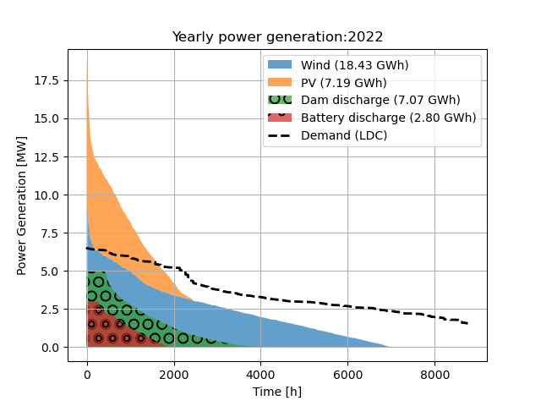
Final electrical mix
Power installed
PV panels : 17.4 MW
Wind turbine : 32 MW
Dam : 5 MW (20h)
Battery : 3 MW (4h)

Slide 25
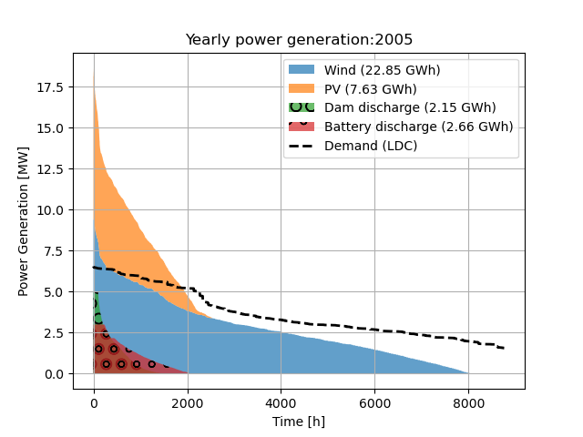
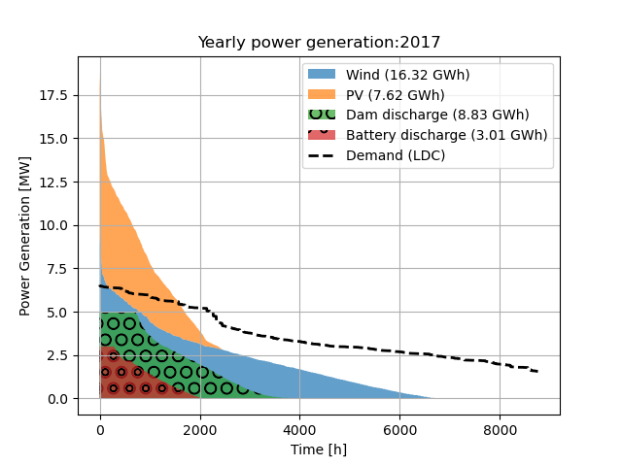
Dry year
Humid year
Total cost : 3.4 M€ → LCOE = 106.60 €/MWh

Slide 26
Why doesn’t the dam store more ?
There is a strong seasonal contrast between the humid and dry periods in Ecuador.
There was more water in 2017 due to extrem rainfall.
When extrem rainfall occurs, the reservoir is quicly full, so the excess water is splilled rather than stored. In 2017, 80 % of water was spilled from the dam.

Slide 27
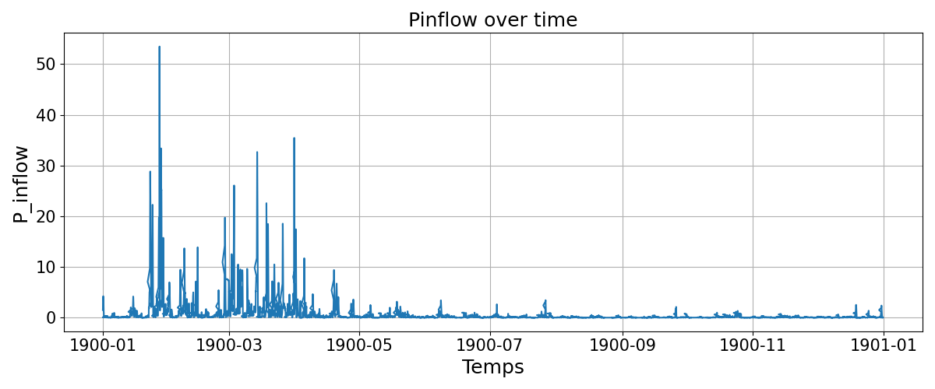
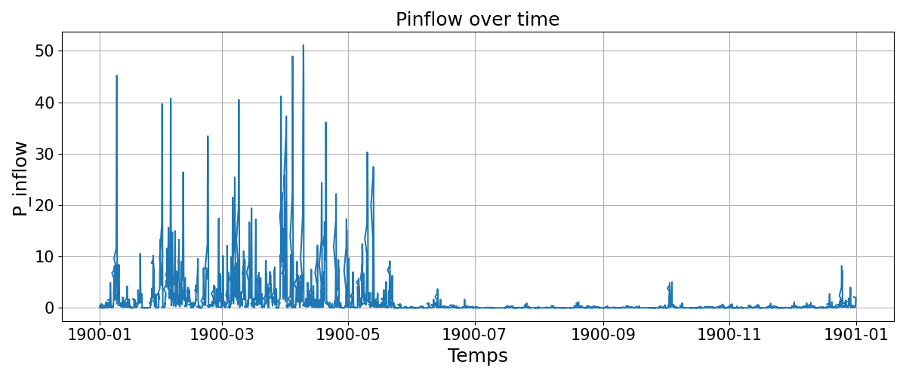
2022
2017

Slide 28
Conclusion
Integrating the dam on the campus allows to observe the variability of hydropower in Ecuador.
These fluctiations cause variations in the cost of importing electricity from the national grid.
The final Levelized cost of Electricity (LCOE) is much higher, since more renewable energy sources must be available to meet electricity demand, even when water suffly is insufficient.
Link to the online repositery : https://github.com/Zazhein/Energy_transition

Slide 29

Thank you!

